Slide 1
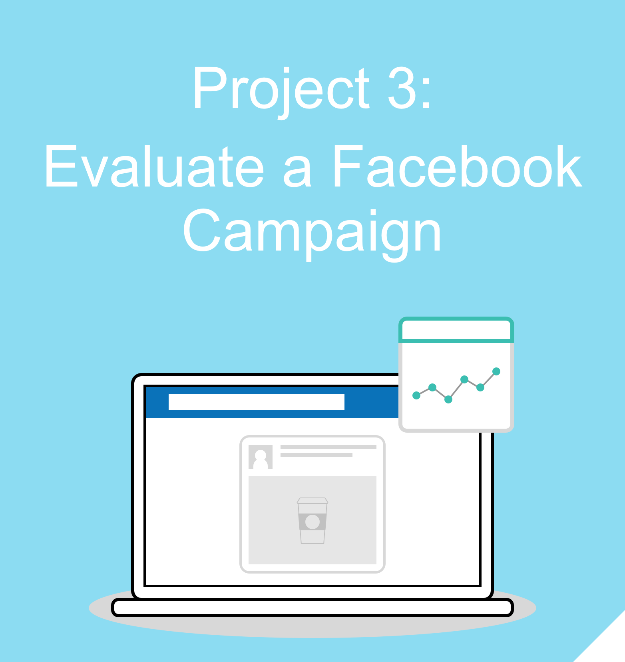


Slide 2
Campaign Summary

Slide 3
Marketing Objective & KPIs
Marketing Objective: To collect the email addresses of 50 potential students for the Digital Marketing Nanodegree Program, with a campaign running for one week and having a lifetime budget of $1000
KPI: Number of eBook downloads

Slide 4

Target Persona
Background and Demographics | Target Persona Name | Needs
Age 27 Female Graduated from university Employed Lives in a mid-size US city | Jessica | Flexible study schedule “Bite-size” chunks of learning
Hobbies | Goals | Barriers
Hiking Photography Walking her dog | Transition into a new career in digital marketing Get a job with higher earning potential/path to advancement Meet other marketers | Limited time for studying/learning new skills Unsure how to break into a new industry

Slide 5
Ad Set
The following three ads are the Ad Set we have designed to target that persona on the previous slide.

Slide 6
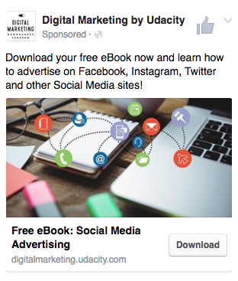
Ad One

Slide 7
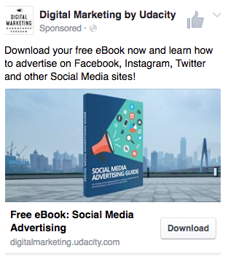
Ad Two

Slide 8
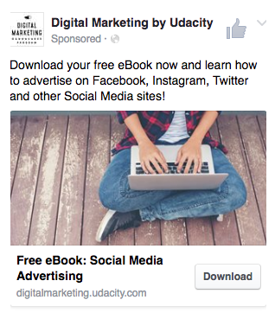
Ad Three

Slide 9
Campaign Evaluation

Slide 10
Campaign Evaluation
Evaluate the success of the campaign, given its marketing objective. Feel free to use bullet points, and add as many slides as you need.
Briefly describe the targeting of the ad set (demographics, location, interest, behavior etc.) Demographics:will be female and male between age 18-35 , Location: ibadan and lagos based only. Interest: will be freelancers, small business owner,student,young graduate,content creation,fashion lover behaviour:shopper,business,fashion,saving,investment,empowerment,children lover etc. By putting together variant of the above audience group,the ad will reach the right audience and achieve the target KPIs
Provide the correct formulas for the following KPIs:
CPM (Cost per 1,000 Impressions):(cost to the advertiser/no of impression)*1000
Link Click-Through Rate:clicks/impression=CTR
CPLC (cost per link click):cost of paid advertisement/number of clicks
Click To Lead Rate:Is the percentage of people who clicked on the ads and are then captured as leads. Divide leads by click and multiply with 100
Cost per Results: total amount spent/total number of result(conversions,leads,video reviews)

Slide 11
Campaign Evaluation
a. Based on the “Key Results” table, identify which ad performed best, and explain why you think this was the case. The second ad had the best performance as it achieved the highest KPI of 43 leads generated. It also the has the lowest cost per result. The book image used for the ad informed the target audience of the expectation.
would you optimize the campaign, and explain why do you think so?
To optimise the campaign, i will check the following. 1:create a lookalike audience of the following.
a: user who interacted with the landing page.
b: Email address of users who downloaded the ebook.
2: change the existing headline of the ad to:
a:free ebook:become a social media manager/advertiser.
b: Free ebook guide to social media advertising.
3:Change the headline of the landing page to:Become a social media advertiser in 3 hours
4:use the same image across all the 3 campaigns but different headlines so i can speak to the target audience differently.

Slide 12
Campaign Evaluation
Write up a high-level overview of how well or not well the campaign performed, based on the marketing objective.
Summary of campaign:
The campaign performed well based on the expected KPIs of 50 eBook downloaded in 2 weeks. In total, the campaign generated 66 downloads using the targeted budget of $1000.
The cost per result of the campaign can be reduced to further increase the performance and drive more downloads.

Slide 13
Campaign Recommendations
Imagine you are tasked with running an improved version of this campaign, with the same marketing objective and KPIs. What recommendations would you make to improve the campaign, based on your evaluation of its past performance?
The current AB test of the campaign compares 3 different images against one another.
My A/B testing will use the same image(media guidebook)but 3 different headlines as my interest is in finding the best performing headline for the campaign .
Ad 1 headline:Free eBook guide to social media advertising.
Ad 2 headline:Free eBook:Becoming a social media manager/advertiser.
Ad 3 headline:Learn social media advertising using this free eBook guide.

